Slide 1
uLCD Driver for Raspberry PI
ECE 4180 Final Project
Yue Teng, Huang Yao
12/15/2021

Slide 2
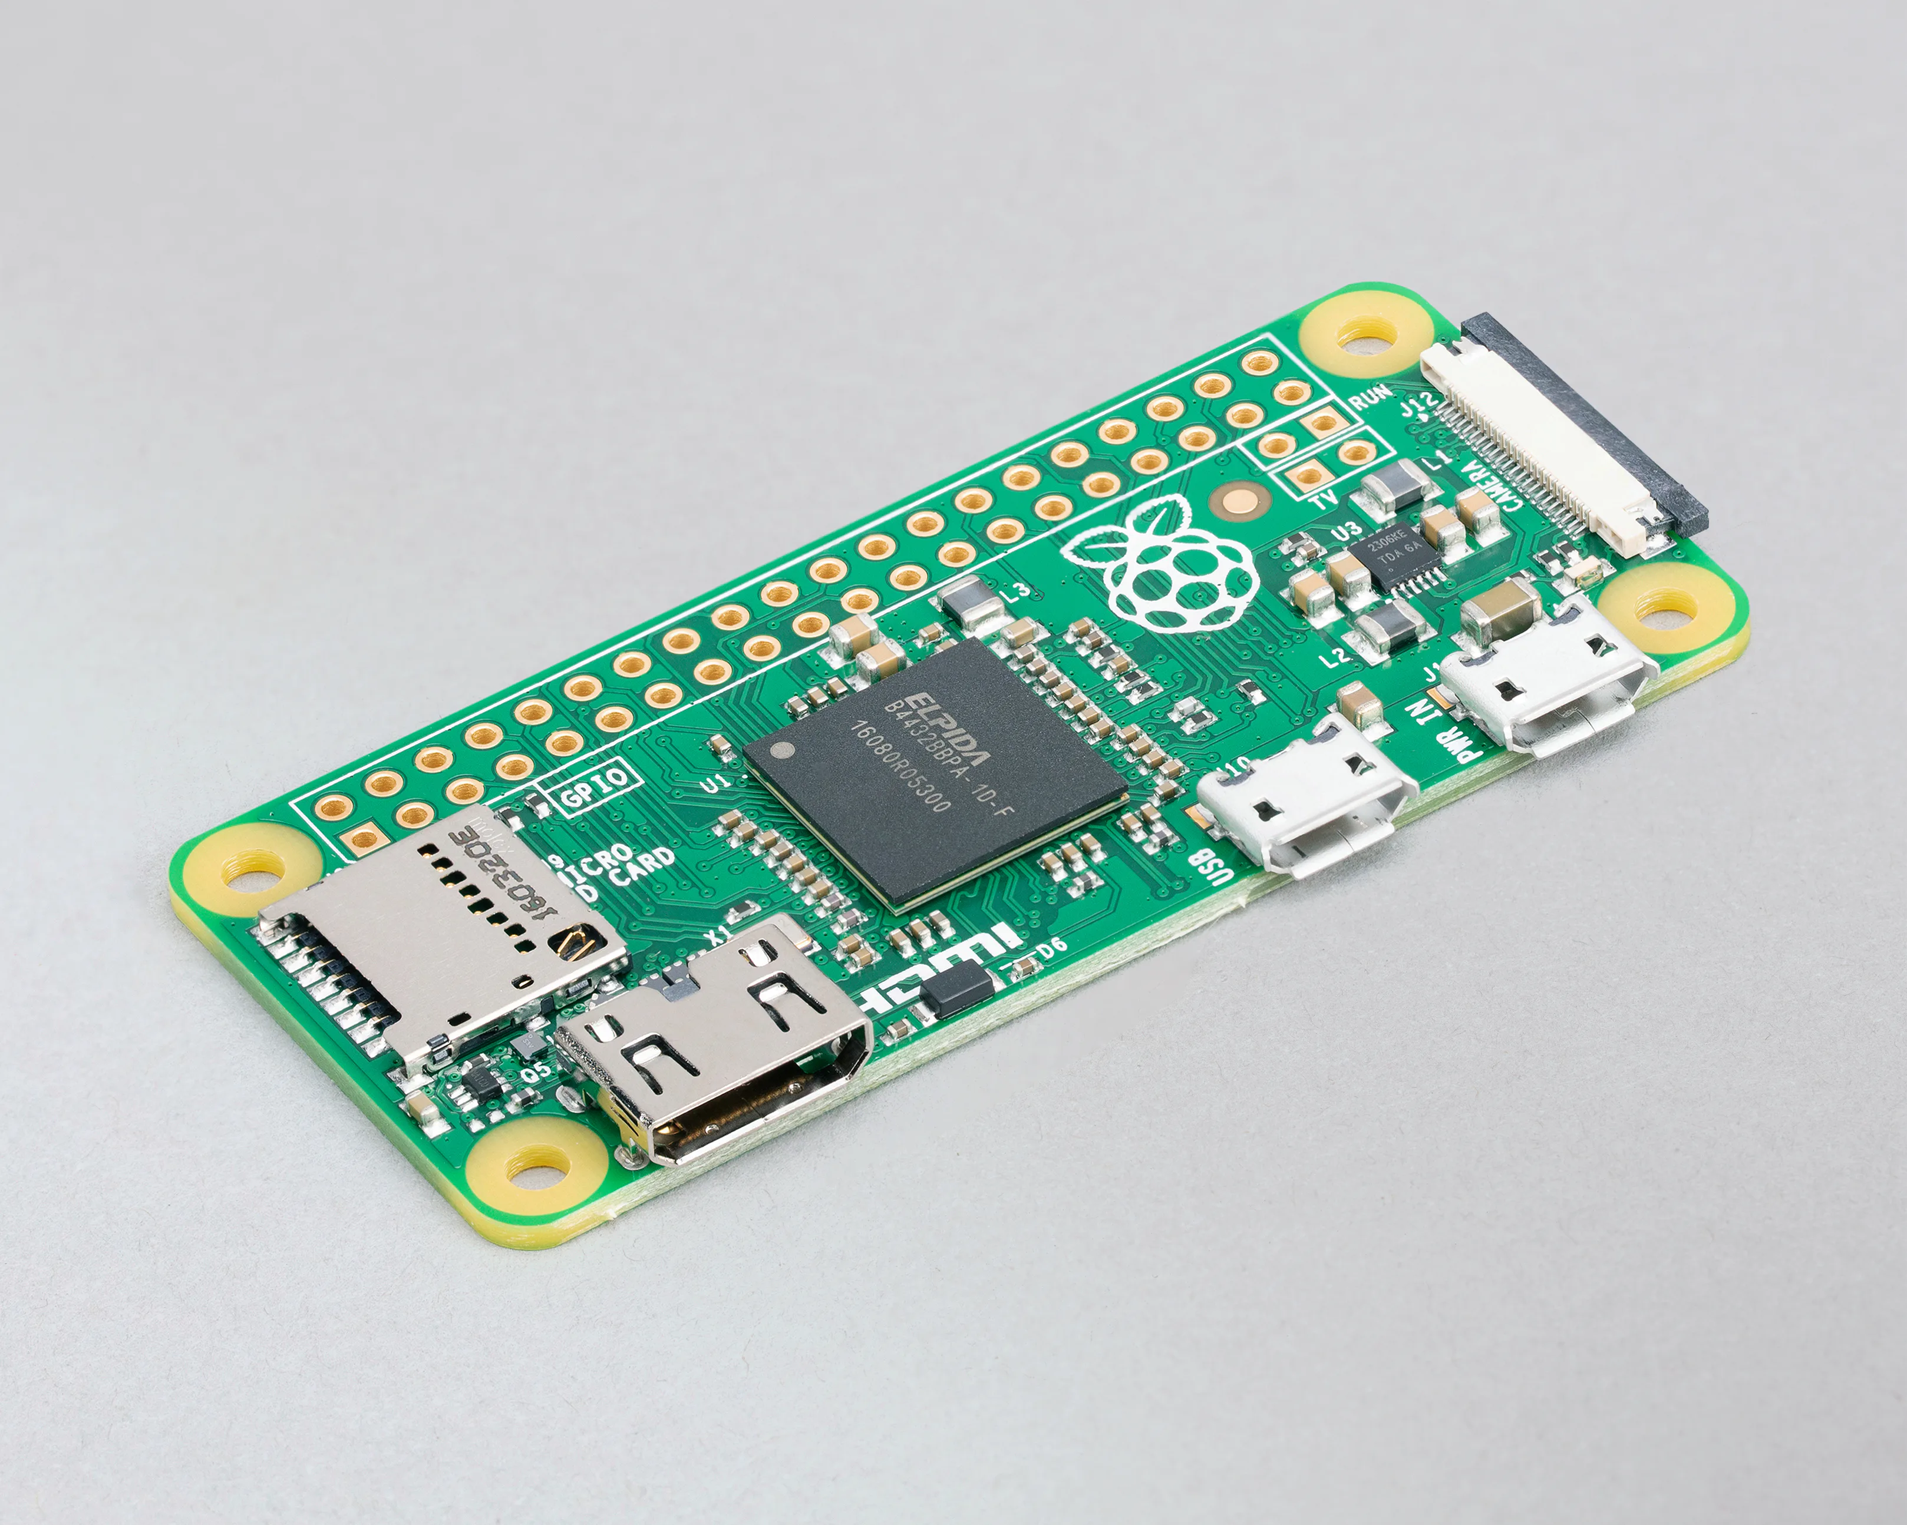
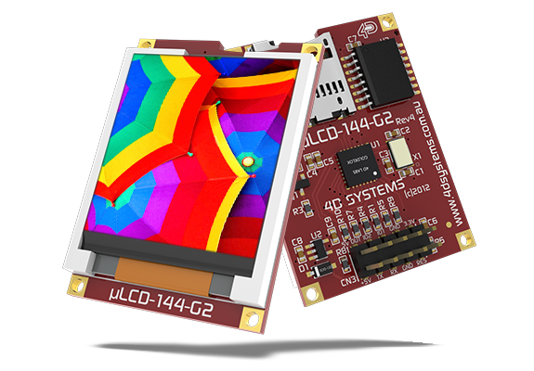
Project Idea
Since Raspberry PI is a popular embedded system, we want to explore more of its functions.
We know that mbed can interact with other hardware such as uLCD through its serial port. We therefore came up with the idea to write a uLCD driver for PI through its serial (UART) port.
SERIAL

Slide 3
Implementation
UART pins TxD, RxD of PI are used for serial communication.
We also used mbeds’ serial communication code with PI to test the functionality of PI’s serial port.
We used mbed’s uLCD_4DGL.h as a draft and made careful adjustments to adapt to PI, such as the following:

Slide 4
Demo

Slide 5
Summary
We see that the data has been successfully transmitted from PI to uLCD through the serial data bus.
Our project is successful, and we have learned more about Raspberry PI and the serial data bus.

